Slide 1
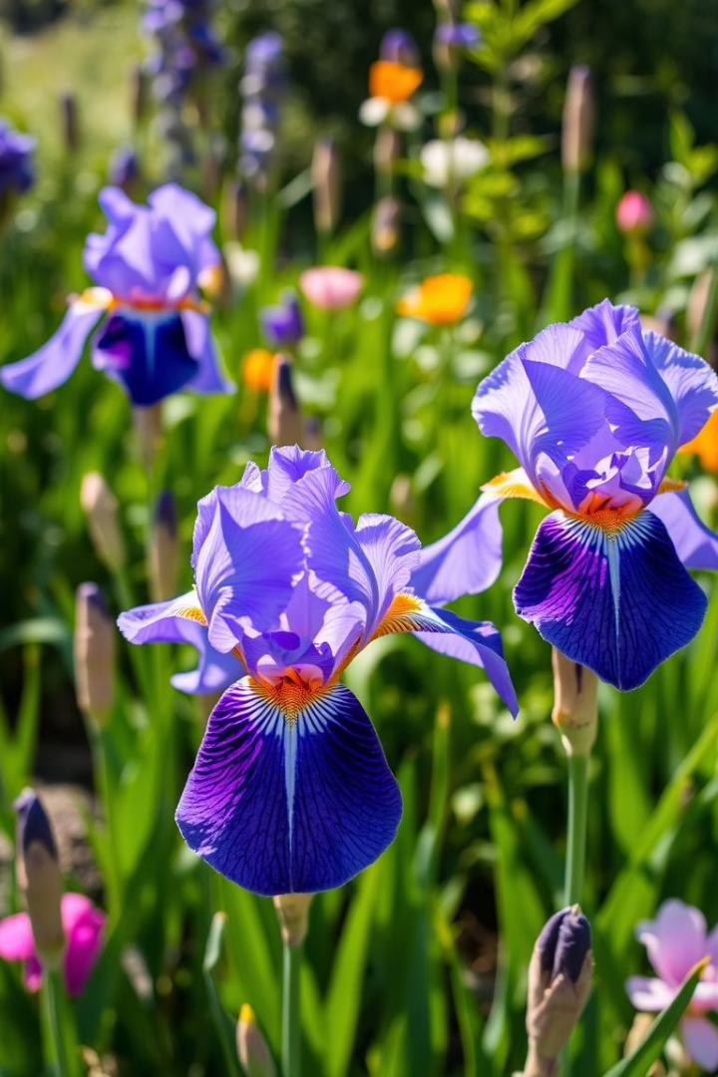

Project Title: Iris Flower Classification
This project classifies iris flowers into three species using machine learning. It demonstrates data handling, visualization, and model building for accurate classification.
by Tanuj Kumar

Slide 2

Tools and Technologies
Kaggle Hub & Environment
Programming & Visualization
Dataset downloaded via Kaggle hub; executed on Google Colab for flexibility.
Python used with Matplotlib and Seaborn libraries for data visualization.
Modeling & Performance
Scikit-learn modules evaluated model accuracy with GPU acceleration speeding training.

Slide 3

Learning Objectives
Data Preprocessing
Load, explore, clean data, and select key features.
Visualization
Use pairplots and heatmaps to reveal data relationships.
Training & Evaluation
Train models, evaluate accuracy, precision, recall.
Classification
Classify iris species with strong model performance.

Slide 4
Methodology
Data Preparation
Modeling
Testing & Validation
Collect datasets and preprocess data by cleaning and feature engineering.
Select and train models, then validate with robust evaluation techniques.
Perform testing on unseen data to confirm accuracy and reliability.

Slide 5

Output Screenshot
Key Outputs
Functional Insights
Visual Results
Accuracy score, confusion matrix, and feature importance highlighted.
Model effectively distinguishes iris species based on feature data.
Clear graphical presentations of model metrics and classification results.

Slide 6

GitHub Repository
Access the complete project and code here:
https://github.com/Tanujkumarsingh/Iris_Flower_Classification_Project

Slide 7

Conclusion & Thank You
Project Success
Feature Insights
Built a high-accuracy Random Forest model for iris classification.
Petal dimensions key to effective species differentiation.
Gratitude
Thank you for your time and interest in this project.

